Slide 1
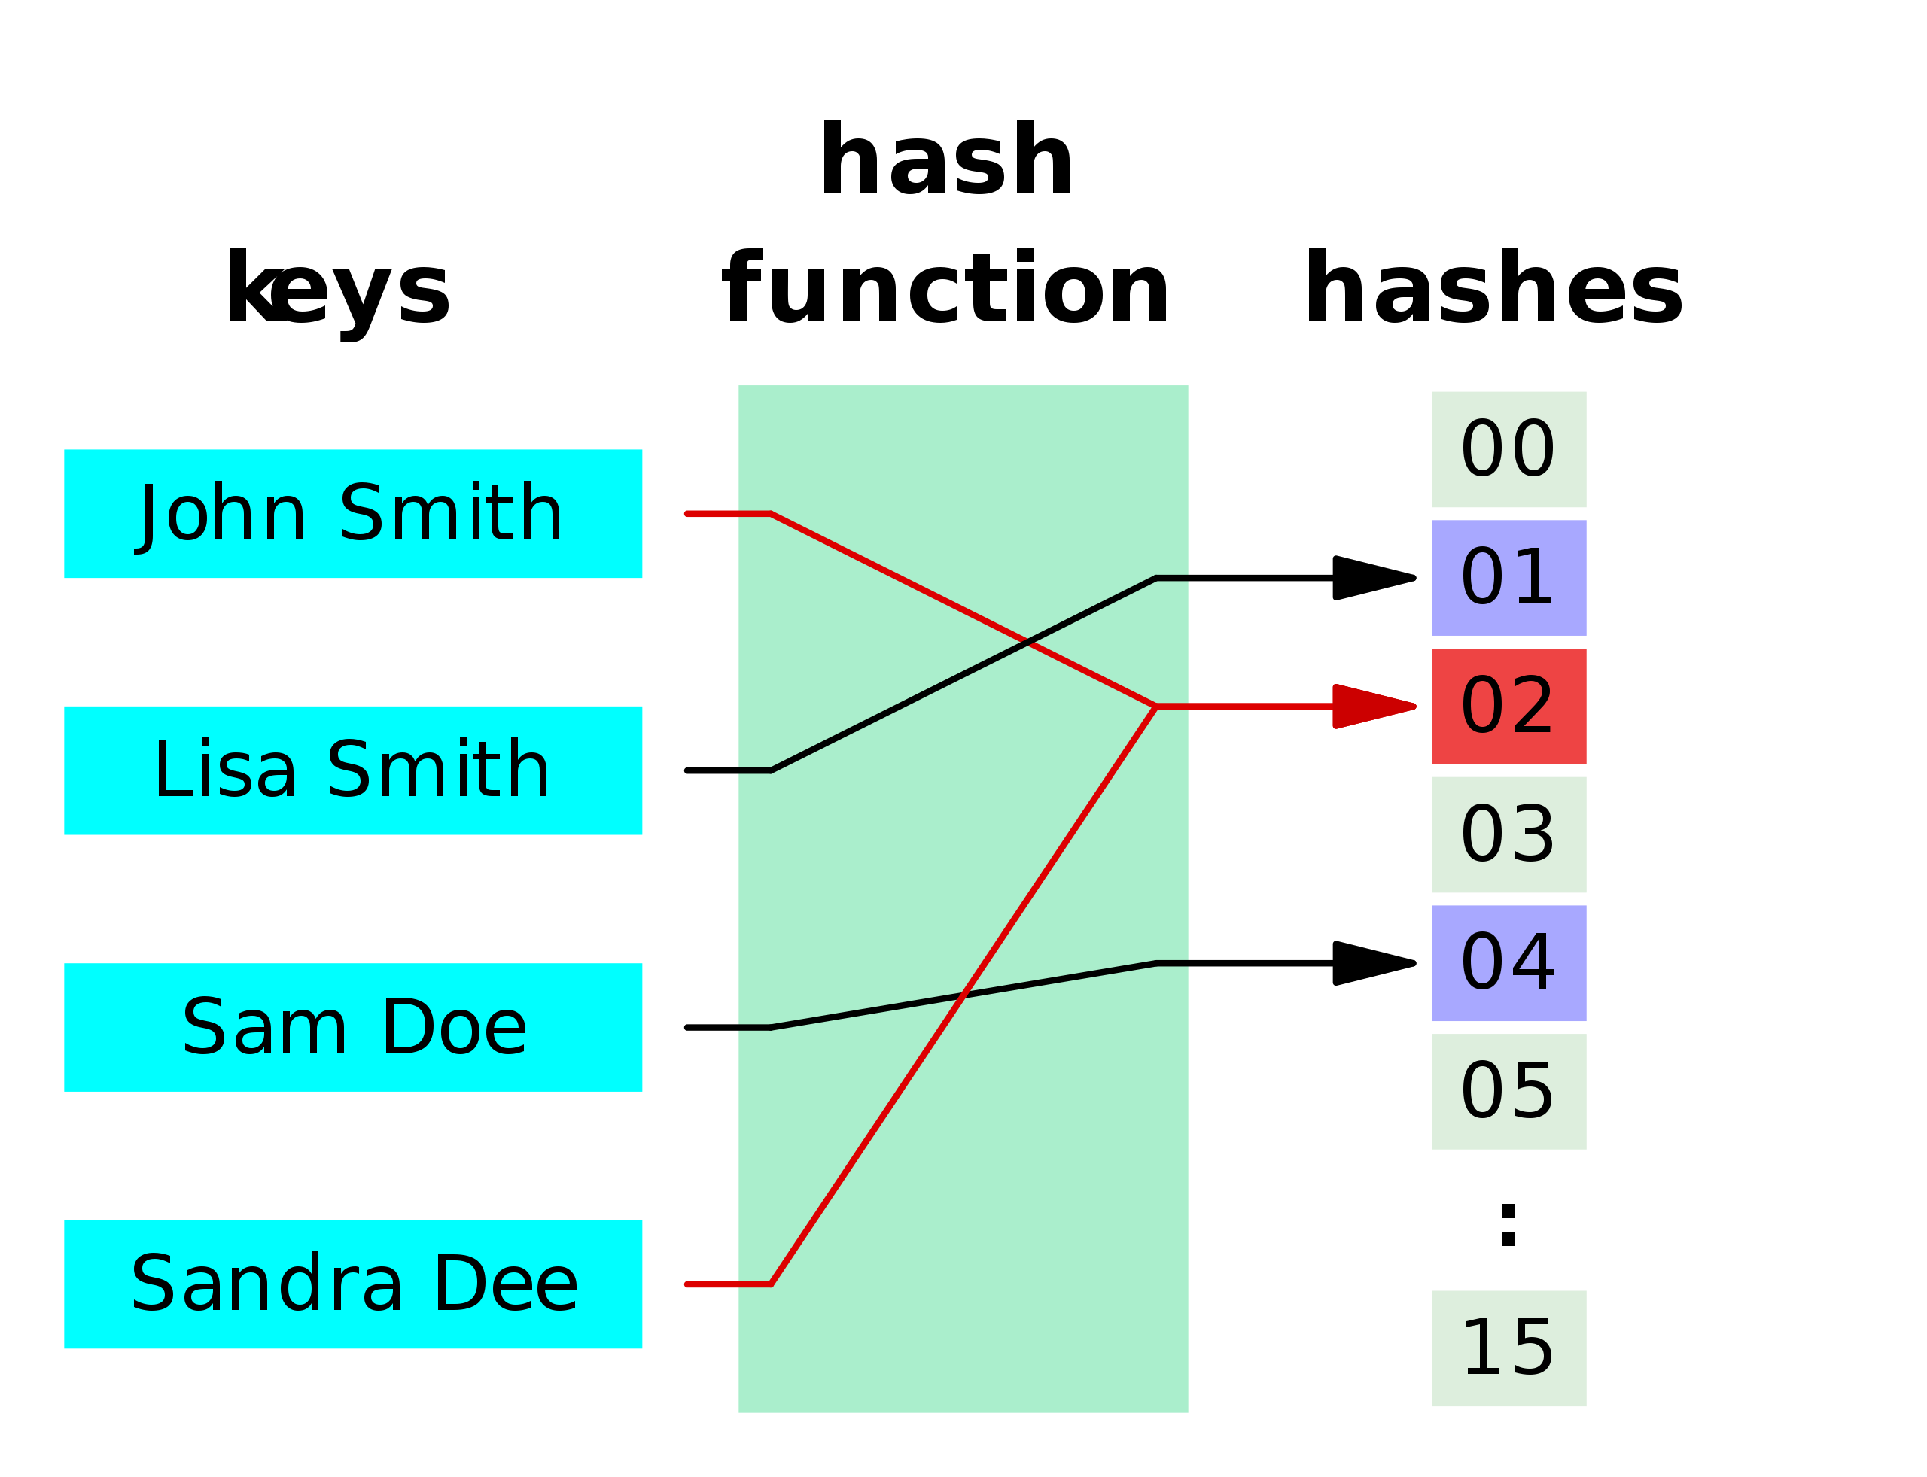
Hashing

Slide 2

What is Hashing?
Hashing is a method of sorting and indexing data. The idea behind hashing is to allow large amounts of data to be indexed using keys commonly created by formulas
Magic function
Apple
18
Mango
Banana
20
22
0
1
..
18
19
20
21
22
23
 |  | .. | Apple |  | Mango |  | Banana

Slide 3
Why Hashing?
It is time efficient in case of SEARCH Operation
Data Structure | Time complexity for SEARCH
Array | O(logN)
Linked List | O(N)
Tree | O(logN)
Hashing | O(1) / O(N)

Slide 4


Hashing Terminology
Hash function : It is a function that can be used to map of arbitrary size to data of fixed size.
Key : Input data by a user
Hash value : A value that is returned by Hash Function
Hash Table : It is a data structure which implements an associative array abstract data type, a structure that can map keys to values
Collision : A collision occurs when two different keys to a hash function produce the same output.
Hash Function
Key
Magic function
Hash Value
Apple
18
Mango
20
Hash Table
Banana
22
0
1
..
18
19
20
21
22
23
 |  | .. | Apple |  | Mango |  | Banana

Slide 5

Hashing Terminology
Hash function : It is a function that can be used to map of arbitrary size to data of fixed size.
Key : Input data by a user
Hash value : A value that is returned by Hash Function
Hash Table : It is a data structure which implements an associative array abstract data type, a structure that can map keys to values
Collision : A collision occurs when two different keys to a hash function produce the same output.
Hash function
ABCD
20
ABCDEF
20
ABCDEF
Collision
0
1
..
18
19
20
21
22
23
 |  | .. |  |  | ABCD

Slide 6
Hash Functions
Mod function
int mod(int number, int cellNumber) { return number % cellNumber;
}
mod(400, 24)
3
mod(700, 24)
1
0
1
..
4
5
..
16
..
23
700 |  | 400 |  |  | .. |  | ..

Slide 7
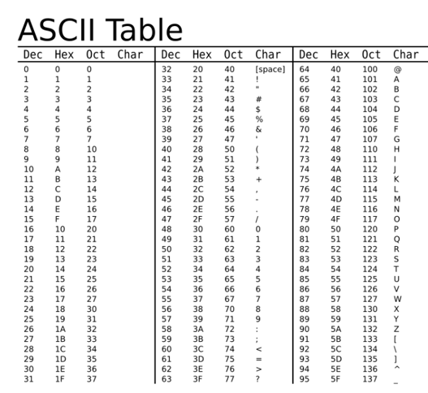
Hash Functions
ASCII function
public int modASCII(String word, int cellNumber) { int total = 0;
for (int i=0; i<word.length(); i++) {
total += word.charAt(i); System.out.println(total);
}
return total % cellNumber;
}
modASCII("ABC", 24)
6
A
B C
65
66
67
65+66+67 = 198
192
24
8
6
0
1
.
6
7
..
16
..
23
 |  | .. | ABC |  | .. |  | ..

Slide 8
Hash Functions
Properties of good Hash function
- It distributes hash values uniformly across hash tables
Hash function
ABCD
20
ABCDEF
20
ABCDEF
Collision
0
1
..
18
19
20
21
22
23
 |  | .. |  |  | ABCD

Slide 9
Hash Functions
Properties of good Hash function
It distributes hash values uniformly across hash tables
It has to use all the input data
ABCD
ABCDEF
Hash function
ABC
18
Collision
0
1
..
18
19
20
21
22
23
 |  | .. | ABCD

Slide 10
Collision Resolution Techniques
0
1
2 | ABCD
3
4
5
6
7
8
9
10
11
12
13
14
15
Collision
Hash function
EFGH
ABCD
EFGH IJKLM
2
2

Slide 11
Collision Resolution Techniques
Resolution Techniques
Direct Chaining
Open Addressing
 |  | Linear Probing
 |  | Quadratic Probing
 |  | Double Hashing

Slide 12
Collision Resolution Techniques
Direct Chaining : Implements the buckets as linked list. Colliding elements are stored in this lists
0
1
2 | 111
3
4
5
6
7 | 444
8
9
10
11
12
13
14
15
Hash function
ABCD
222
EFGH
333
IJKLM
Null
ABCD
EFGH IJKLM
pip
2
2
2
7
Null
Null
111
222
333
PIP
Null
444

Slide 13
Collision Resolution Techniques
Open Addressing: Colliding elements are stored in other vacant buckets. During storage and lookup these are found through so called probing.
Linear probing : It places new key into closest following empty cell
0
1
2 | ABCD
3 | EFGH
4 | ĲKLM
5
6
7
8
9
10
11
12
13
14
15
Hash function
ABCD
EFGH IJKLM
2
2
2

Slide 14
Collision Resolution Techniques
Open Addressing: Colliding elements are stored in other vacant buckets. During storage and lookup these are found through so called probing.
Quadratic probing : Adding arbitrary quadratic polynomial to the index until an empty cell is found
0
1
2 | ABCD
3 | EFGH
4
5
6 | ĲKLM
7
8
9
10
11
12
13
14
15
1², 2², 3², 4²..
Hash function
2 + 1² = 3
2 + 2² = 6
ABCD
EFGH IJKLM
2
2
2

Slide 15
Collision Resolution Techniques
Open Addressing: Colliding elements are stored in other vacant buckets. During storage and lookup these are found through so called probing.
Double Hashing : Interval between probes is computed by another hash function
0
1
2 | ABCD
3
4
5
6 | EFGH
7
8 | ĲKLM
9
10
11
12
13
14
15
Hash function
2 + 4 = 6
ABCD
EFGH IJKLM
2
2
2
2 + 4 = 6
2 + (2*4) = 8
Hash Function 2
EFGH
IJKLM
4
4

Slide 16
Hash Table is Full
Direct Chaining
This situation will never arise.
Hash function
ABCD
EFGH
IJKLM NOPQ RSTU
2
1
3
0
1
0 |  | 111
1 |  | 222
2 |  | 333
3 |  | 444
NOPQ
Null
111
EFGH
555
RSTU
Null
Null
222
555
ABCD
Null
333
IJKLM
Null
444

Slide 17
Hash Table is Full
Open addressing
Create 2X size of current Hash Table and recall hashing for current keys
Hash function
ABCD
EFGH
IJKLM NOPQ RSTU
2
1
3
0
1
0 | NOPQ
1 | EFGH
2 | ABCD
3 | IJKLM
0 | NOPQ
1 | EFGH
2 | ABCD
3 | IJKLM
4 | RSTU
5
6
7

Slide 18
Pros and Cons of Collision Resolution Techniques
Direct chaining
Hash table never gets full
Huge Linked List causes performance leaks (Time complexity for search operation becomes O(n).)
Open addressing
Easy Implementation
When Hash Table is full, creation of new Hash table affects performance (Time complexity for search operation becomes O(n).)
If the input size is known we always use “Open addressing”
If we perform deletion operation frequently we use “Direct Chaining”

Slide 19
Pros and Cons of Collision Resolution Techniques
Hash function
ABCD
EFGH
IJKLM NOPQ RSTU
2
0 | NOPQ
1 | EFGH
2
3 | IJKLM
4 | RSTU
Linear Probing
1
3
0
1
ABCD

Slide 20

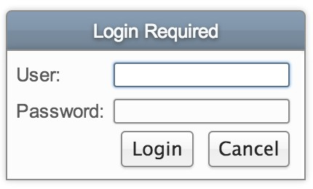

Practical Use of Hashing
Personal Computer
Password verification
Login : pankaj@gmail.com
Password: 123456
Google Servers
Hash value: *&71283*a12

Slide 21


Practical Use of Hashing
Password verification
File system : File path is mapped to physical location on disk

Slide 22

Practical Use of Hashing
File system : File path is mapped to physical location on disk
Path: /Documents/Files/hashing.txt
0
1 | /Documents/ Files/hashing.txt
2
3
Physical location: sector 4

Slide 23
Pros and Cons of Hashing
On an average Insertion/Deletion/Search operations take O(1) time.
x When Hash function is not good enough Insertion/Deletion/Search operations take O(n) time
Operations | Array | Linked List | Tree | Hashing
Insertion | O(N) | O(N) | O(LogN) | O(1)/O(N)
Deletion | O(N) | O(N) | O(LogN) | O(1)/O(N)
Search | O(N) | O(N) | O(LogN) | O(1)/O(N)

